Slide 1
Project Title
• AI Echo: Your Smartest Conversational Partner
• Ashutosh Rana :310522104007
•Rakesh Chowdhary:310522104012
• Akash:310522104002
• Anbarasan:310522104006
• B.E Computer Science Engineering
• Dhanalakshmi Srinivasan College Of Engineering & Technology
• Nithya R
• 13/05/2005

Slide 2
Problem Statement
Sentiment analysis is a natural language processing (NLP) technique used to determine the sentiment expressed in a given text. This project aims to analyze user reviews of a ChatGPT application and classify them as positive, neutral, or negative based on the sentiment expressed. The goal is to gain insights into customer satisfaction, identify common concerns, and enhance the application's user experience.

Slide 3
Proposed Solution
AI Echo is a Streamlit-based app that:
Accepts ChatGPT review text
Performs sentiment analysis (Positive/Neutral/Negative)
Provides exploratory data insights (EDA)
Shows trend patterns and keyword analysis
Uses ML models for accurate prediction

Slide 4
Dataset Used
Data Source: Scraped ChatGPT user reviews
Fields: Review text, rating, sentiment, date, version, platform, location
Preprocessing: cleaning, labeling, TF-IDF vectorization
Balanced dataset with resampling techniques

Slide 5
Exploratory Data Analysis (EDA)
Sentiment distribution (Positive > Negative > Neutral)
Trend over time shows spikes after version updates
Verified users show more positive reviews
Longer reviews often reflect stronger (positive or negative) sentiments
Web users gave more neutral feedback vs mobile users
Top negative feedback themes: hallucination, delay, inaccuracy

Slide 6
Models Used
Classical ML models:
• Logistic Regression
• Random Forest
• Naïve Bayes
• XGboost

Slide 7
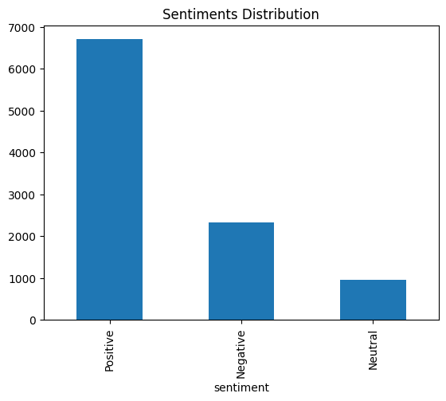
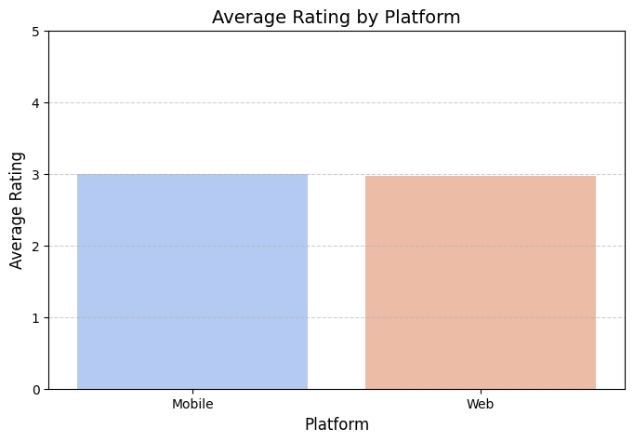
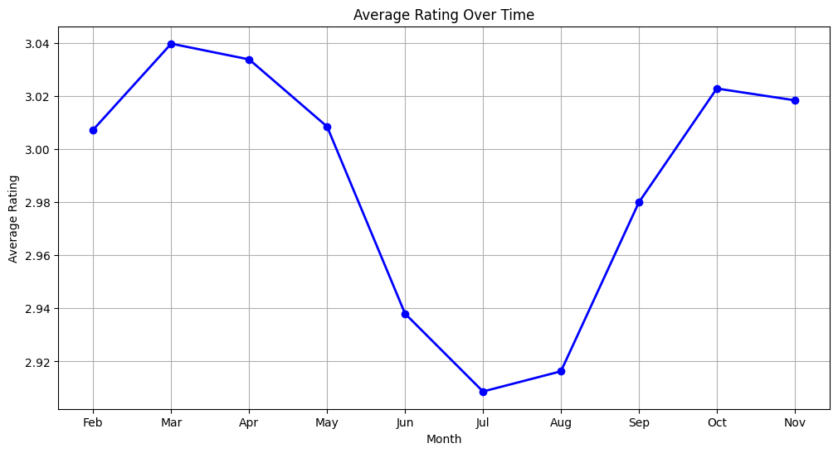
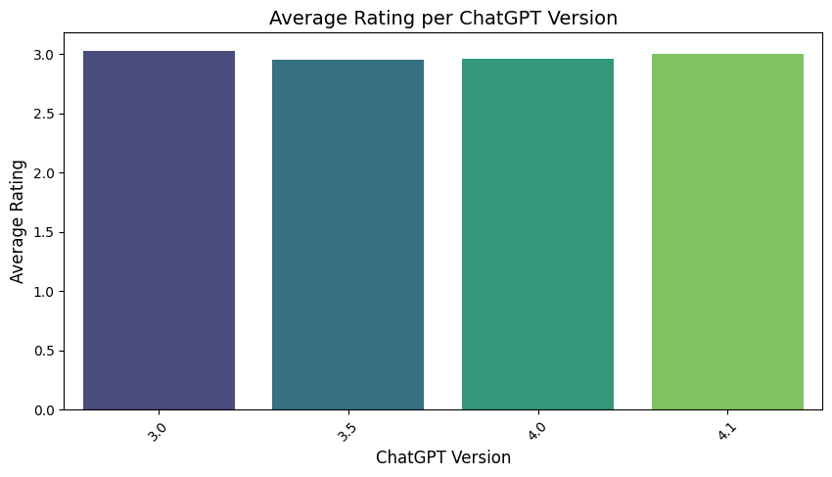

Slide 8
Conclusion
AI Echo demonstrates the power of NLP and Machine Learning
in extracting meaningful insights from user reviews.
The project successfully classifies user sentiments into Positive,
Negative, and Neutral with high accuracy using optimized models.
Extensive EDA helped uncover patterns based on platform usage,
verification status, review length, version type, and geography.
These insights can drive better product improvements, user
experience strategies, and support personalization

